Slide 1
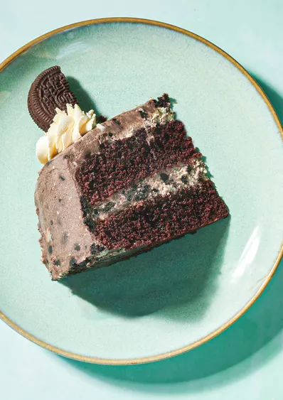
Cake recipe
Oreo Cake With Oreo Whipped Cream Frosting Recipe

Slide 2

Table of contents
About this cake
Nutrition
Recipe details
Ingredients
Special equipment
Directions
Conclusion

Slide 3

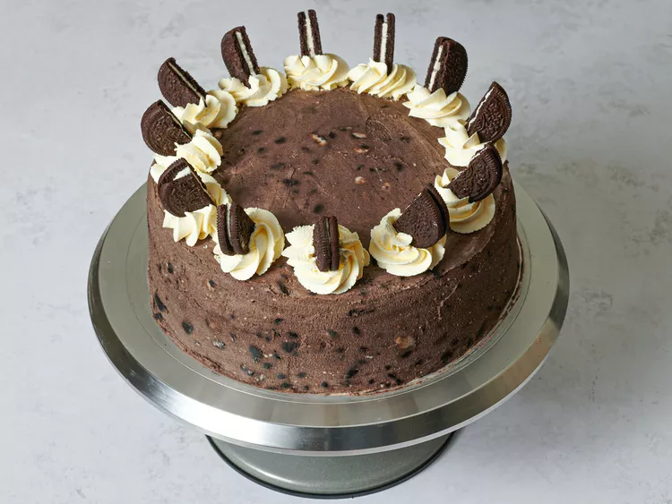

About this cake
This simple yet impressive chocolate cake is layered and topped with Oreo whipped cream.
This was made by Yvonne Ruperti as she is a food writer, recipe developer, former bakery owner, and cookbook author. She is also an adjust professor of baking at the Culinary Institute of America in Singapore.

Slide 4
Nutrition Facts(per serving)
851 Calories
59g Fat
75g Carbs
9g Protein
144mg Cholesterol

Slide 5
Recipe details
Prep: 45 mins
Cook: 25 mins
Active: 45 mins
Chilling Time: 3 hrs 15 mins
Total: 4 hrs 25 mins
Serves: 12 servings

Slide 6
Ingredients
For the cake:
1 1/2 cups all-purpose flour (about 7 1/2 ounces; 212g)
1/2 cup cocoa powder (about 1 1/2 ounces; 42g)
1 1/4 teaspoons baking soda
1/4 teaspoon Diamond Crystal kosher salt; if using table salt, use half as much by volume
1 cup plus 4 tablespoons granulated sugar (about 8 2/3 ounces; 244g)
1 cup plus 4 tablespoons sour cream (about 8 1/2 ounces; 240g)
2/3 cup (160ml) vegetable oil
2 large eggs
1 teaspoon (5ml) vanilla extract

Slide 7
Ingredients (continued)
For the Oreo Whipped Cream:
50 Oreo cookies
4 1/2 cups (about 1L) heavy cream
2 tablespoons (30g) granulated sugar
1 tablespoon (15ml) vanilla extract

Slide 8
Special Equipment
Two 9-inch cake pans
Stand mixer

Slide 9
Directions
For the Cake:
1. Adjust oven rack to middle position and preheat oven to 350°F (180°C). Line bottoms of two 9-inch cake pans with parchment paper and lightly coat the insides with non-stick pan spray. Sift flour, cocoa, baking soda, and salt into a large bowl; set aside. In a medium bowl, whisk together sugar, sour cream, oil, eggs, and vanilla until smooth.
2. Whisk wet ingredients into dry ingredients until smooth. Divide batter evenly between prepared cake pans. Place pans together on one oven rack and bake until cake is just firm and toothpick inserted into center comes out with moist crumbs, about 25 minutes. If oven has uneven heat, pause to rotate the pans after about 12 minutes. Let cakes cool in pans for 15 minutes, then run a butter knife around the edges to loosen. Invert onto a wire rack, peel off the parchment, and return cakes right side up. Cool cakes completely on wire rack, about 1 hour.

Slide 10
Directions (continued)
For the Oreo Whipped Cream:
3. Carefully cut 6 Oreo cookies in half; set aside. Chop remaining cookies into 1/4-inch pieces; set aside.
4. In the bowl of a stand mixer fitted with whisk attachment, whip 2 cups cream on medium-high speed until thick and fluffy. Transfer to a large bowl and place in refrigerator. In the same mixer bowl, whip remaining 2 1/2 cups cream, sugar, and vanilla until thick and fluffy. Using a flexible spatula, fold sweetened whipped cream into already whipped cream.
5. Transfer 1 cup whipped cream to a small bowl and refrigerate until ready to decorate cake. Fold chopped Oreos into remaining whipped cream.

Slide 11
Directions (continued)
To Assemble the Cake:
6. Level cakes with a serrated knife and set scraps aside for snacking. Place one layer on a heavy cast iron turntable. If you like, a waxed cardboard cake round can first be placed underneath, secured to the turntable with a scrap of damp paper towel. Top with about one-third of the Oreo whipped cream, using an offset spatula to spread it evenly from edge to edge. Top with second layer and then cover the top and sides of the cake with remaining Oreo whipped cream, spreading it as smoothly as you can. Refrigerate cake to let cookies soften, about 2 hours.

Slide 12
Directions (c0ntinued)
7. Re-whisk reserved whipped cream and transfer to a pastry bag fitted with star tip. Pipe 12 whipped cream rosettes around perimeter of cake and garnish with reserved Oreo cookie halves.
8. Serve.

Slide 13

Conclusion
This cake should be enough to feed 12 people so don’t be greedy unless you’re eating the cake by yourself or if there isn’t 12 people.
ENJOY!

